Slide 1
CSE331
Automata and computability
Regular Expression
Summer 2026

Slide 2
Today's learning goals Sipser Ch 1.3
Decide whether or not a string is described by a given regular expression
Design a regular expression to describe a given language

Slide 3
Recap
Regular sets of strings i.e., those that aren't too complicated are those that are
the language of some DFA, or equivalently,
the language of some NFA.
If a set of strings can be expressed as the result of complement, union, intersection, concatenation, Kleene star of regular languages, then it itself is regular.

Slide 4
Regular expressions
Can all regular languages be expressed as those that are built up from very simple languages using the regular operations?

Slide 5
DFAs vs Regular Expressions
DFAs – check if a given word is in the language
Regular Expressions – generate all words in the language

Slide 6
The regular operations Sipser Def 1.23 p. 44
For A, B languages over same alphabet, define:
These are operations on sets!

Slide 7
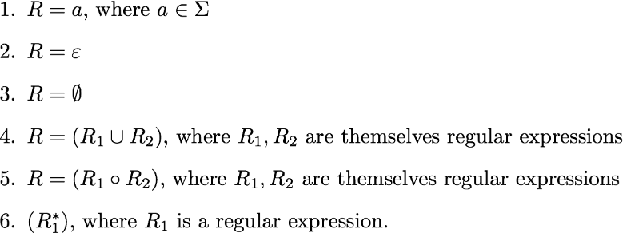
Inductive application of closure Sipser 1.52 p. 64
R is a regular expression over Σ if
Σ is shorthand for (0 U 1) if Σ = {0,1}, Parentheses may be omitted, R⁺ means RR*, R^{k} means R concatenated with itself k times
Watch out for overloaded symbols!

Slide 8
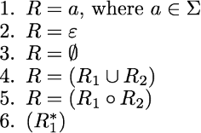
Syntax → Languages
The language described by a
regular expression, L(R):
L ( (0 U 1)U1 ) = { }
L ( 1* 1 ) = { }
L ( ) = { }

Slide 9
Syntax → Languages
The language described by a
regular expression, L(R):
L (Σ*(00+11)Σ*) = { }
L ( Σ(ΣΣ)* ) = { }
L ( 0*10*10* ) = { }

Slide 10
Syntax → Languages
The language described by a
regular expression, L(R):
L ( (0U1)o(0U1)o(0U1))* = { }

Slide 11
L(R)
Which of the following strings is not in the language described by
( ( (00)*(11) ) U 01 )*
00
01
1101
I don't know

Slide 12
L(R)
Let L be the language over {a,b} described by the regular expression
((a U Ø) b*)*
Which of the following is not true about L?
Some strings in L have equal numbers of a's and b's
L contains the string aaaaaa
a's never follow b's in any string in L
L can also be represented by the regular expression (ab*)*
More than one of the above.

Slide 13
L(R)
Review: Determine whether each statement below about regular expressions over the alphabet {a, b, c} is true or false:
True or False: ab ∈ L((a U b)*)
True or False: ba ∈ L(a*b*)
True or False: ab ∈ L(a U b U c)
True or False: ε ∈ L((a U b)*)
True or False: ε ∈ L(aa* U bb*)

Slide 14

Writing Regular Expression
Example
Write regular expression which generates
L₁ = {w | length of w is 1 or more}

Slide 15
Writing Regular Expression
Example
Write regular expression which generates
L₂ = {w | w contains at lease two 1s}

Slide 16
Writing Regular Expression
Example
Write regular expression which generates
L₃ = {w | w contains at most two 1s}

Slide 17
Writing Regular Expression
Example
Write regular expression which generates
L₄ = {w | length of w is not divisible by 3}

Slide 18
Writing Regular Expression
Example
Write regular expression which generates
L₅ = {w | 0s and 1s alternate in w}

Slide 19
Writing Regular Expression
Example
Write regular expression which generates
L₆ = {w | w doesn’t contain 00 and 11}

Slide 20
Writing Regular Expression
Example
Write regular expression which generates
L₇ = {w | w doesn’t end with 01}

Slide 21
Writing Regular Expression
Example
Write regular expression which generates
L₈ = {w | w doesn’t contain 00}

Slide 22
Writing Regular Expression
Example
Write regular expression which generates
L₉ = {w | w doesn’t contain 10}

Slide 23
Writing Regular Expression
Example
Write regular expression which generates
L₁₀ = {w | w starts and ends with different symbols}

Slide 24
Writing Regular Expression
Example
Write regular expression which generates
L₁₁ = {w | w starts and ends with the same symbols}

Slide 25

Writing Regular Expression
Example
Write regular expression which generates
L₁₂ = {w | w has an even number of copies of the substring ab}
The main observation needed here is that the way to get two copies of ab is to have a nonempty run of a's, then a nonempty run of b's, then a nonempty run of a's, and then another nonempty run of b's. To get an even number of copies of ab, you need to repeat this pattern multiple times. Finally, accounting for what comes before that first run of a's and after that last run of b's, we can come up with this regex:

Slide 26

Writing Regular Expression
Example
Write regular expression which generates
L₁₃ = {w | w ≠ ab}
This one is a little trickier than it looks because there is no easy way to say “everything but ab” in regex-speak. We need to figure out what structure the other strings all share that ab doesn’t.
There are a lot of ways to solve this one, but my personal favorite is to use the following observation. Any string that isn't ab is either
length 0, 1, or 3 or more, or
length 2 and not ab.
We can directly encode option (1) and enumerate all choices for option (2) to get this regex:

Slide 27
Writing Regular Expression
Example
L₁₄ = { w | number of 0s in w is a multiple of 3 }
L₁₅ = { w | every 1 is followed by at least one 0 }
L₁₆ = {1^{m}0^{n} | m, n ≥ 1}
L₁₇ = {L₁₄ ∩ L₁₅ ∩ L₁₄}

Slide 29
Regular expressions in practice
Compilers: first phase of compiling transforms Strings to Tokens keywords, operators, identifiers, literals
  One regular expression for each token type
Other software tools: grep, Perl, Python, Java, Ruby, …

Slide 30
"Regular = regular" Sipser Theorem 1.54 p. 66
Theorem: A language is regular if and only if some regular expression describes it.
Lemma 1.55: If a language is described by a regular expression, then it is regular.
Lemma 1.60: If a language is regular, then it is described by some regular expression

